Slide 1

Online Book Store System
Presented By: 1.Omkar Thakur.
2.Nikhil Mali.
3.Aniket.
4.Karan Mhatre.
5.Sanket.
Guided By: Praisy JohnWillson.

Slide 2
Contents
• Introduction/Objective.
• Existing vs Proprosed System.
• Software and Hardware Requirement.
• Introduction About Software.
• Modules.
• Rest API.
• Back End And Frond End Connection.
• Diagrams.
• Screenshots.
• Conclusion.

Slide 3
Introduction
• Online bookstore project can manage all the working of
Online shopping website and it also manage the back
office process whenever we buy books online
• The main objective of the project is to create an online
book store that allows users to search and purchase a
book based on title, author and Category.
• The Administrator will have additional functionality when
compared to the common user. Admin can add, delete
and update the author, book categories.

Slide 4

Existing vs proposed system
Existing system
Amazon
Proposed system
To get the knownledge and to develop
my skills I had develop this system.
In this system only admin can
add,delete,update and store the
details of books.

Slide 5

Requirements:
• Hardware requirement:
Processor:
RAM:
Core i3 or more
2GB
Hardisk:
60GB
Input device:
Output device:
KEYBOARD,MOUSE
MONITOR
• Software requirement:
Operating system:
Language:
Windows 10
Java
Front-end:
Angular,html,css
Mysql
Back-end:

Slide 6
Introduction about software
• Eclipse:
The Eclipse IDE is famous for our Java Integrated
Development Environment (IDE), but we have a number of
pretty cool IDEs, including our C/C++ IDE,
JavaScript/TypeScript IDE, PHP IDE, and more.
Spring:
The Spring Framework (Spring) is an open-source
application framework that provides infrastructure
support for developing Java applications. One of the
most popular Java Enterprise Edition (Java EE)
frameworks, Spring helps developers create high
performing applications using plain old Java objects
(POJOs).

Slide 7
Vs code:
• Visual Studio Code is a free coding editor that helps you
start coding quickly. Use it to code in any programming
language, without switching editors. Visual Studio
Code has support for many languages, including Python,
Java, C++, JavaScript, and more.
• Angular is a popular web development platform
developed by Google. The Visual Studio Code editor
supports Angular IntelliSense and code navigation out of
the box.

Slide 8
MySql
• MySQL is a database management system.
• It may be anything from a to a picture gallery or
the vast amounts of information in a corporate
network. To add, access, and process data stored
in a computer database, you need a database
management system such as MySQL Server.

Slide 9
Modules:
• Login
• Create Book
• Search Book
• Edit Book
• Sale Book
• Delete Book

Slide 10
Rest API.
• http://localhost:8085/api/book-list
Add new book:
• http://localhost:8085/api/add-new-book
Book Get by id:
• http://localhost:8085/api/book/1
Count :
• http://localhost:8085/api/number-of-books/2
Update :
• http://localhost:8085/api/books/2
Delete:
• http://localhost:8085/api/book/2
Sale:
• http://localhost:8085/api/sell-book/1

Slide 11
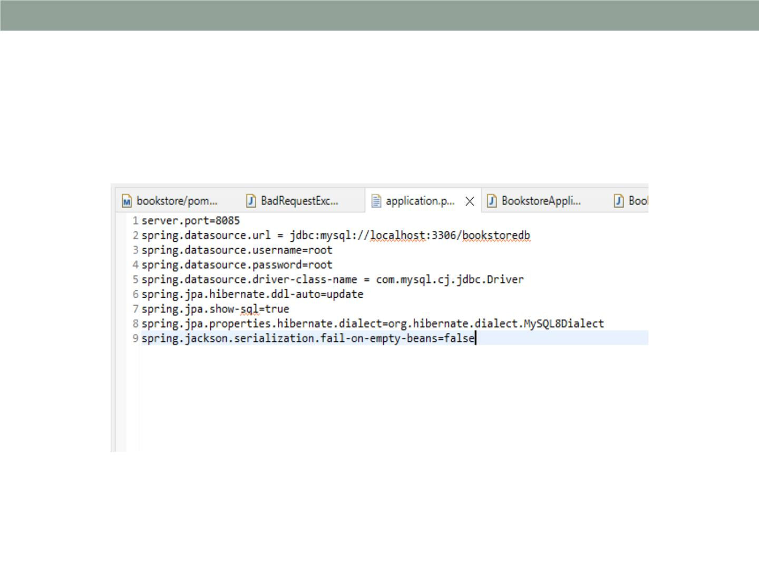
Front-end and Back-end Connection:

Slide 12
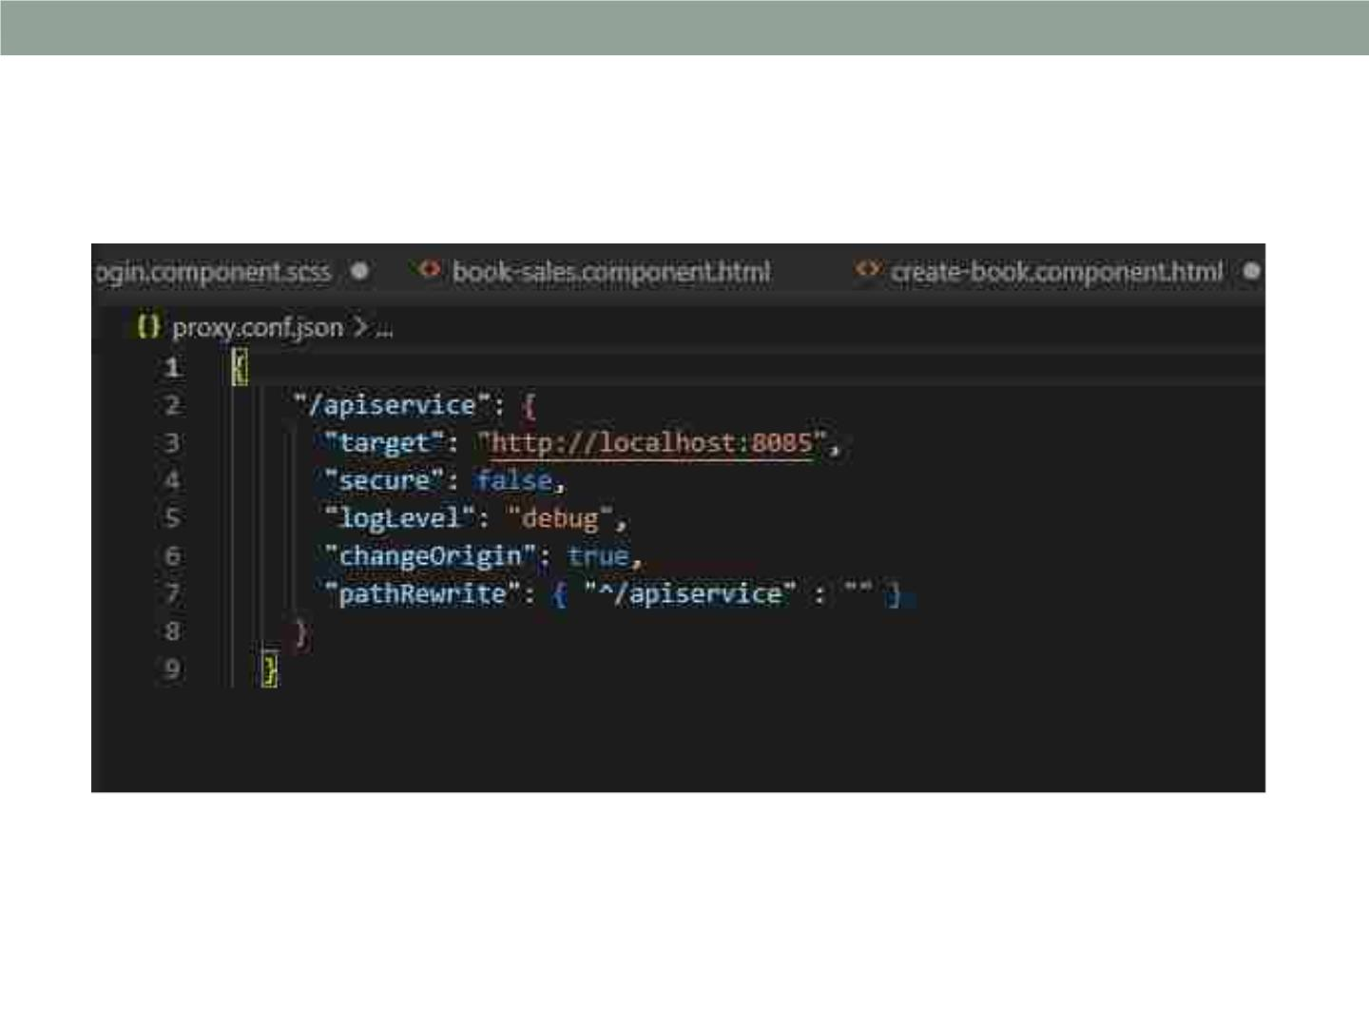
Vs code

Slide 13
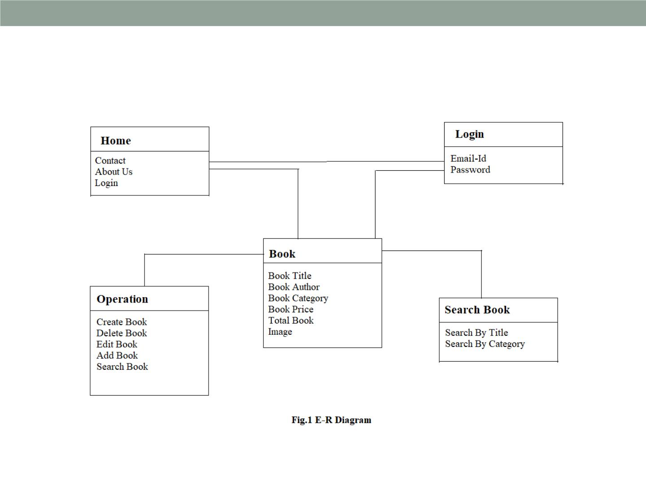
Diagrams:
1)E-r diagram

Slide 14
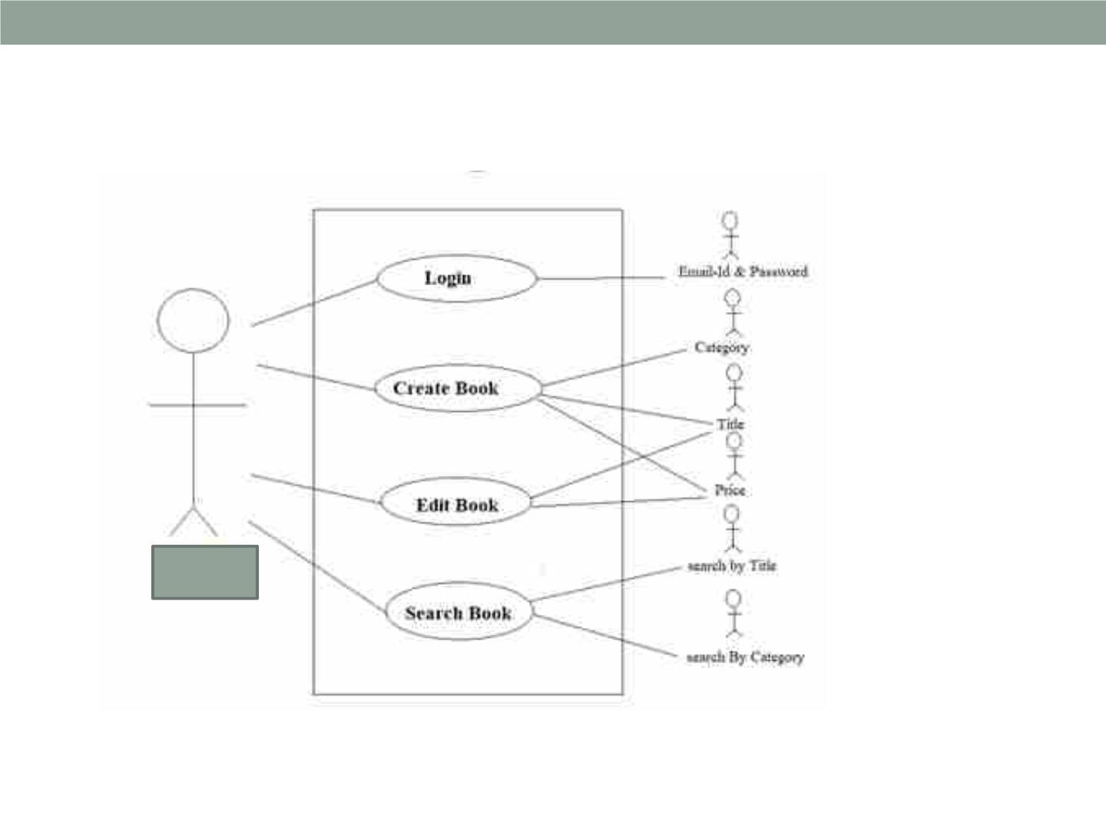
2)Use case diagram:
admin

Slide 15
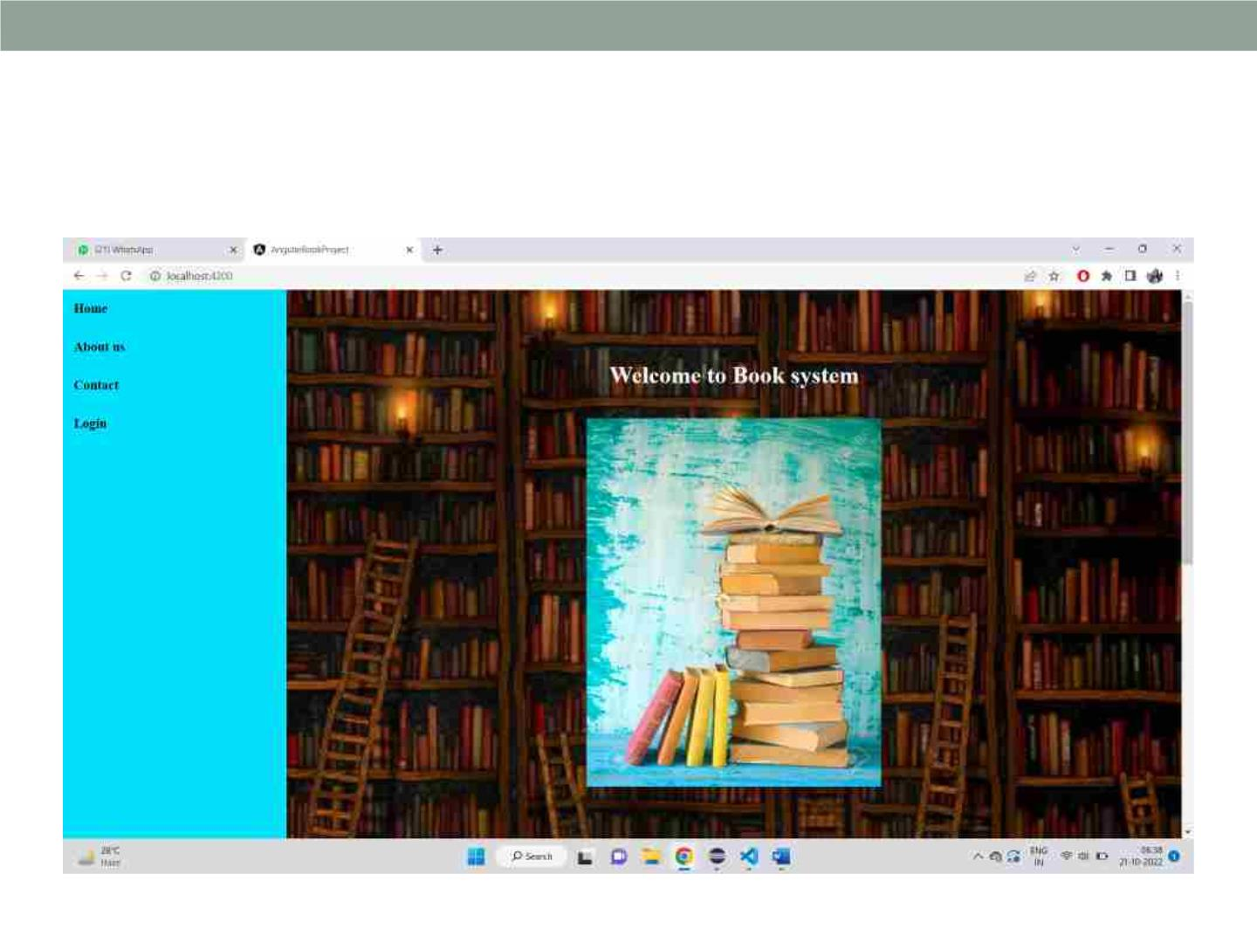
Welcome Page:

Slide 16
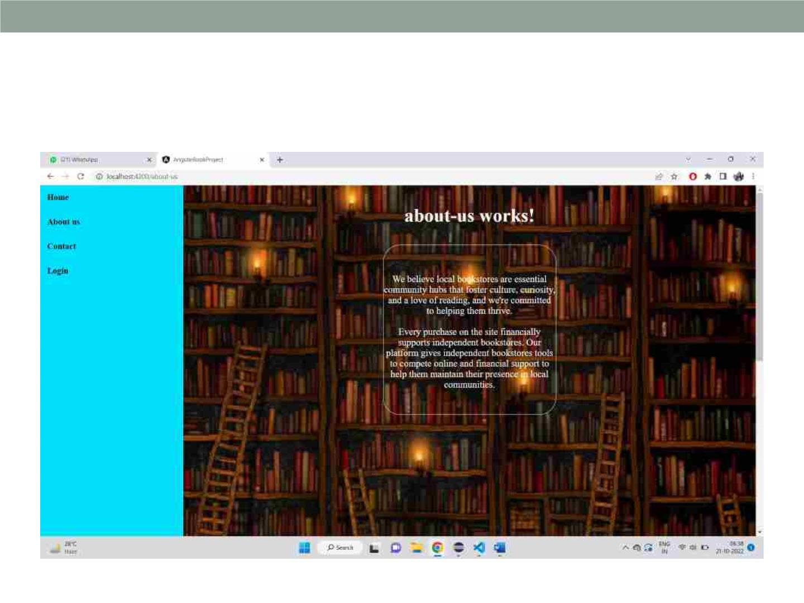
About us:

Slide 17

Contact us:

Slide 18
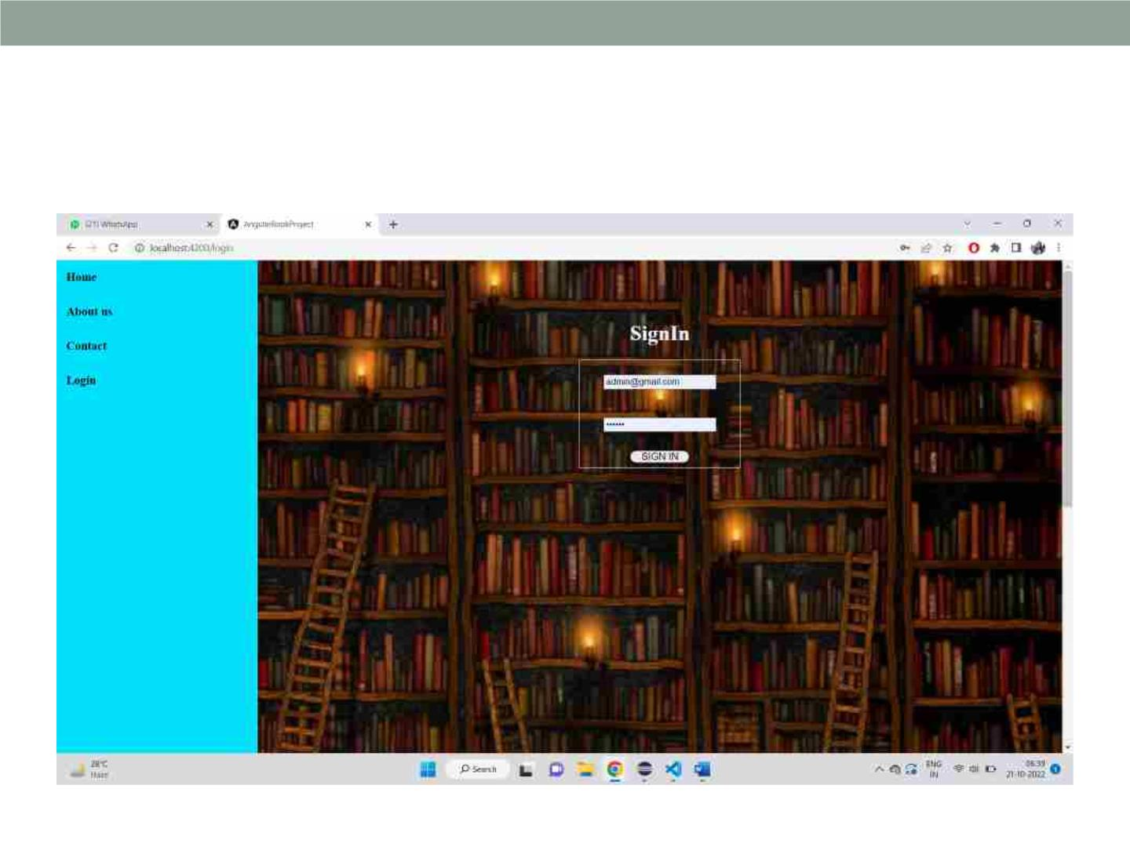
Login Page:

Slide 19
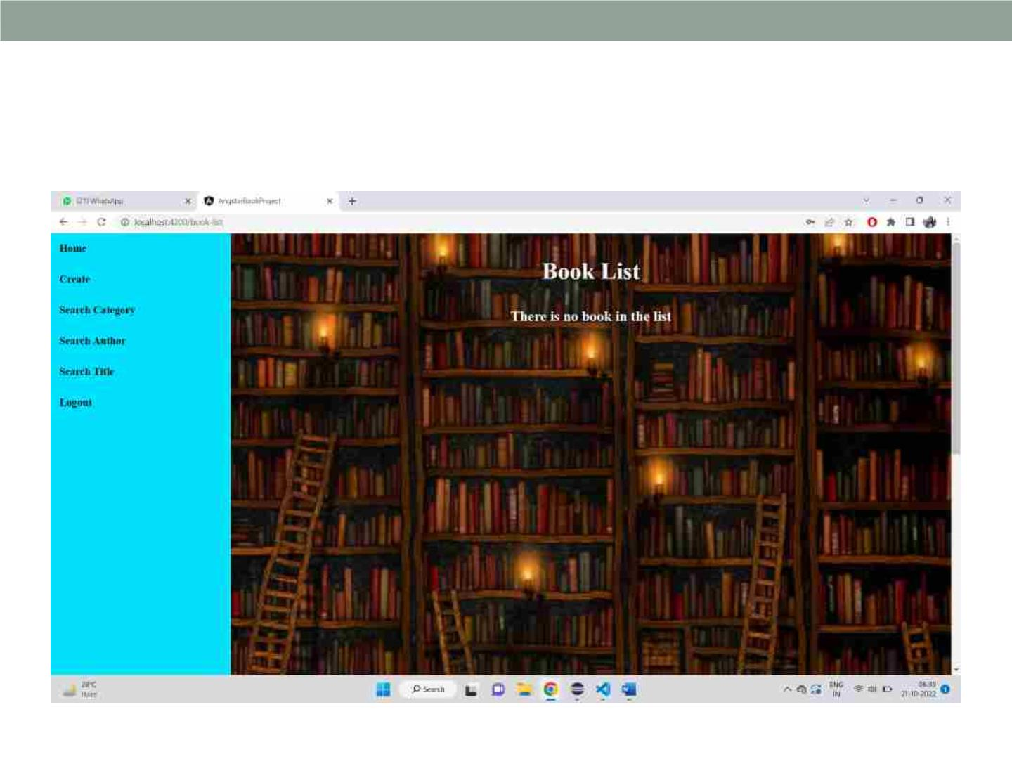
Home Page:

Slide 20

Create a book page:

Slide 21

Filled information of book:

Slide 22
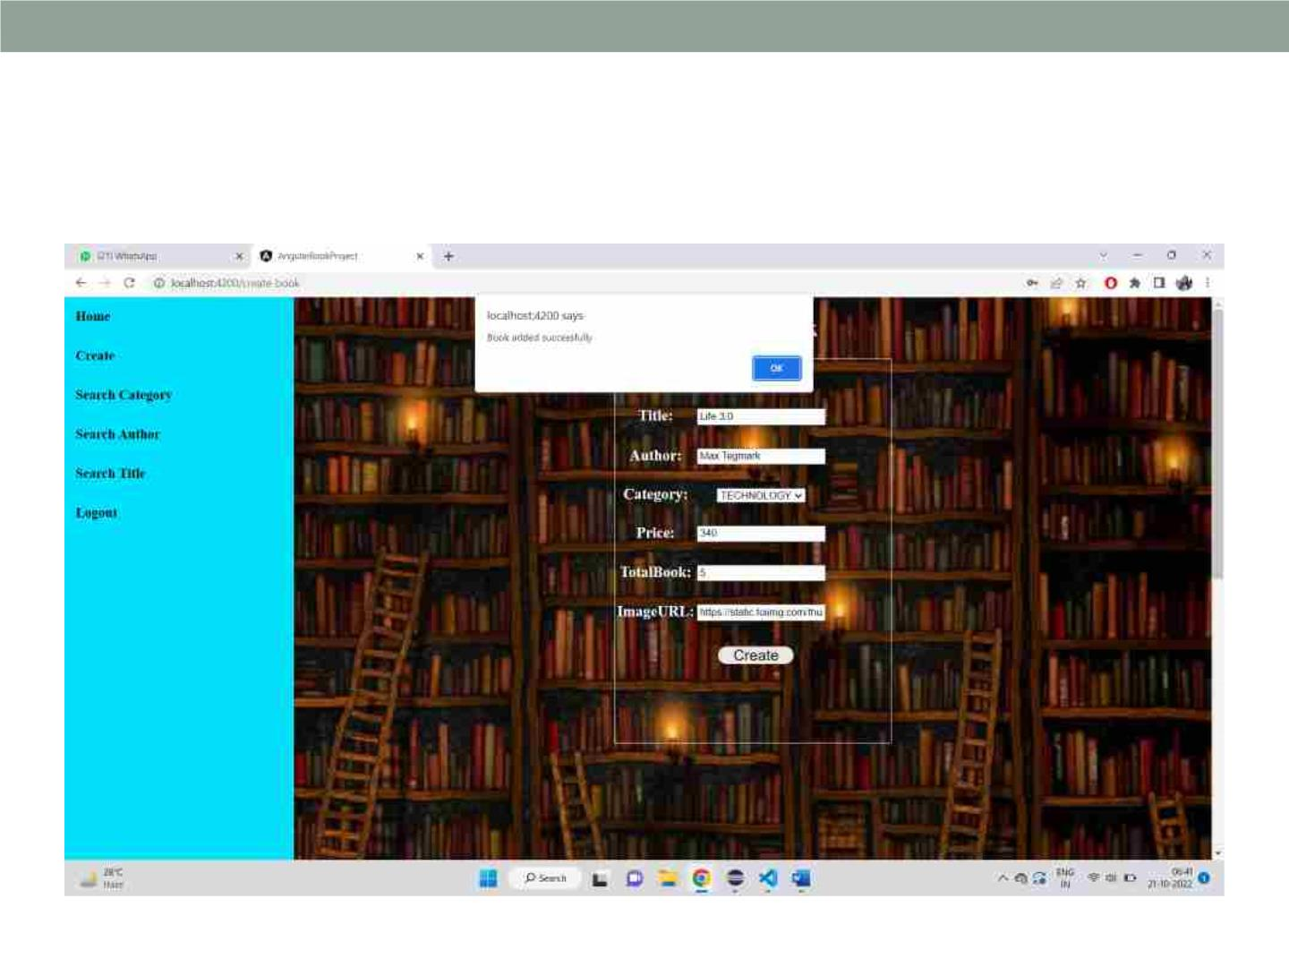
Book is added:

Slide 23
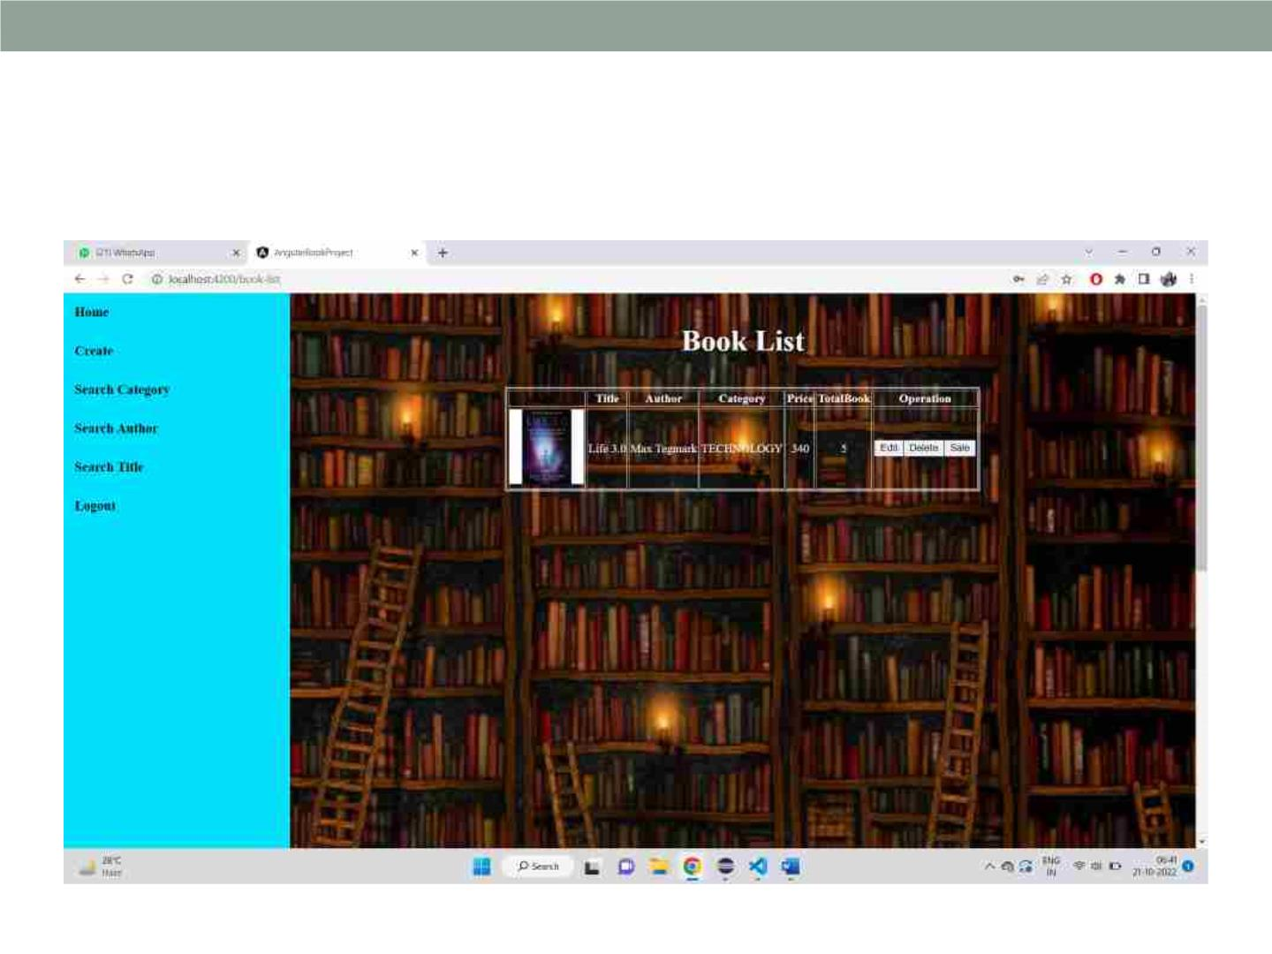
Display book:

Slide 24
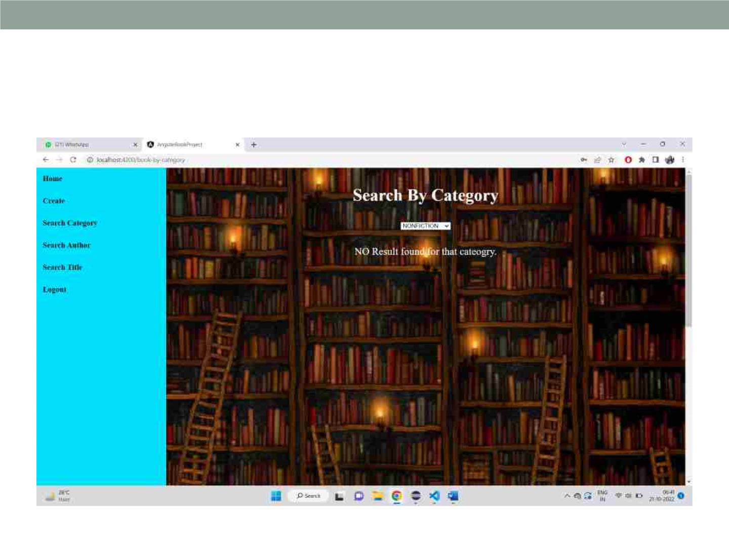
Before search category:

Slide 25
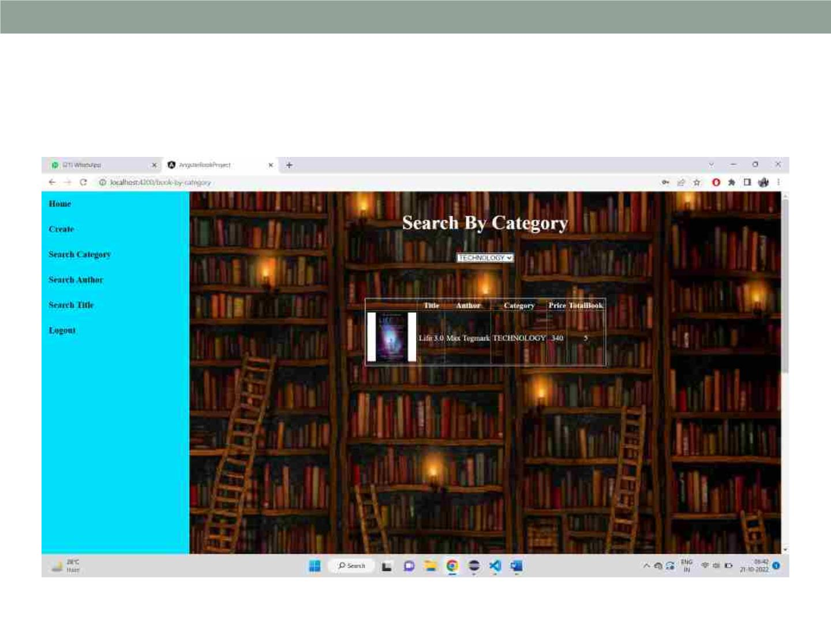
After search category:

Slide 26

Search by author:

Slide 27
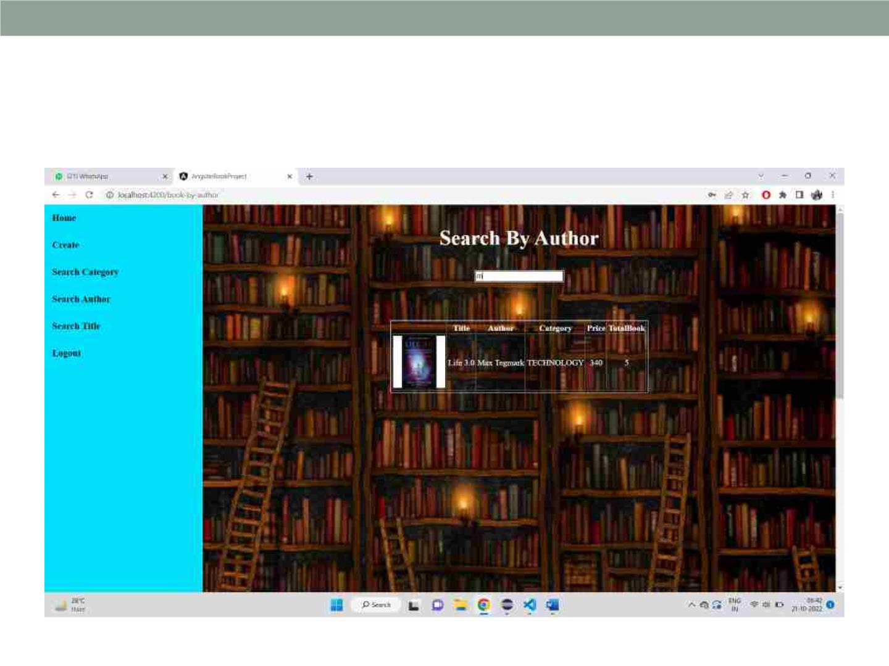
After searching author:

Slide 28

Search by title:

Slide 29

After searching title:

Slide 30
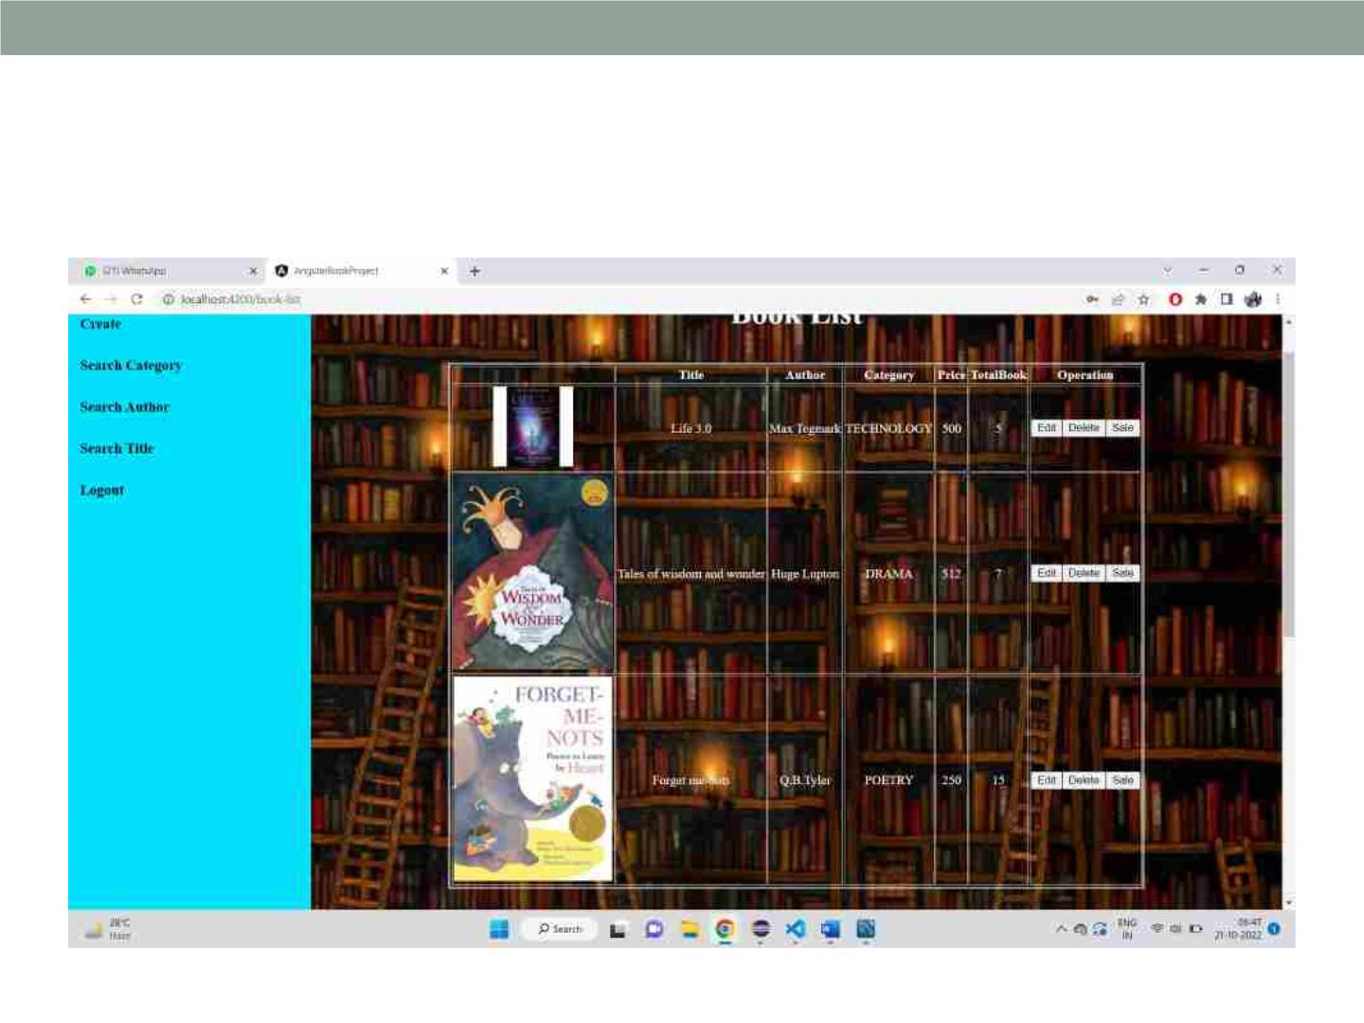
Another books added:

Slide 31
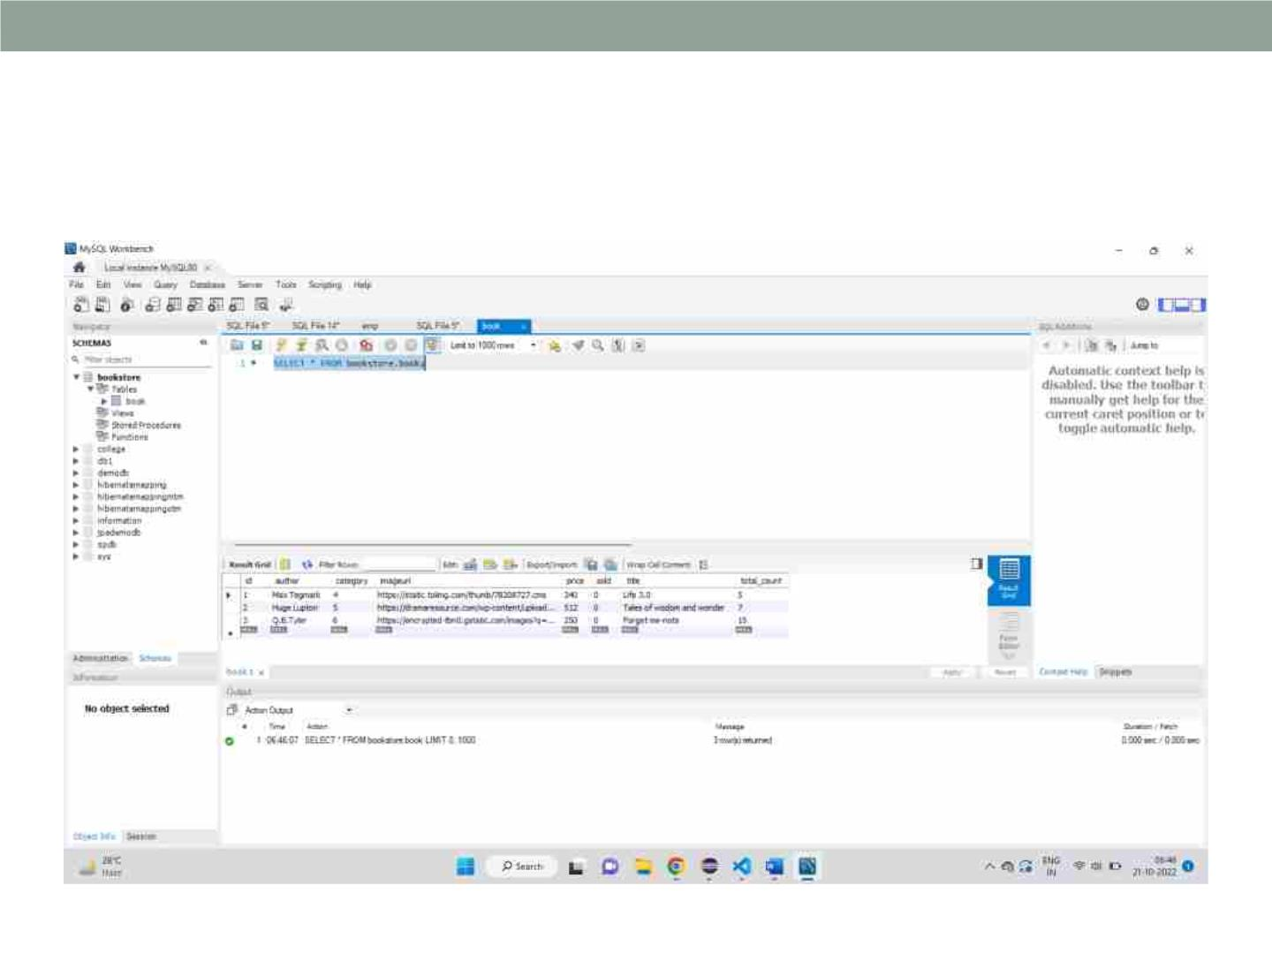
Added books in database:

Slide 32
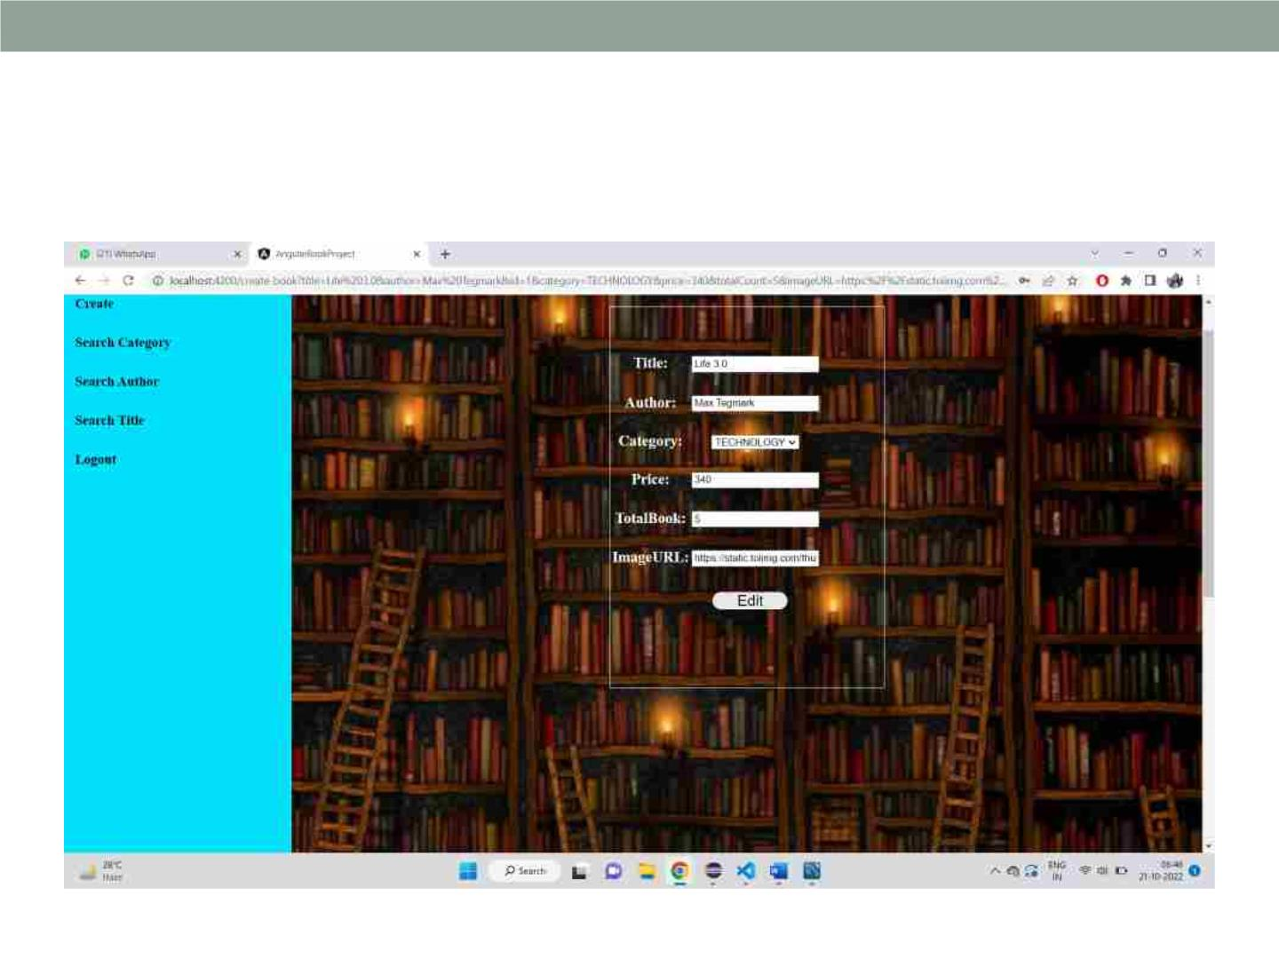
Before editing:

Slide 33

After editing:

Slide 34
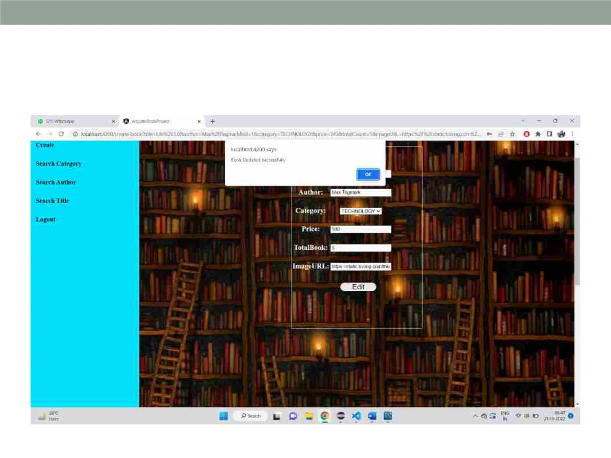
Book is updated:

Slide 35
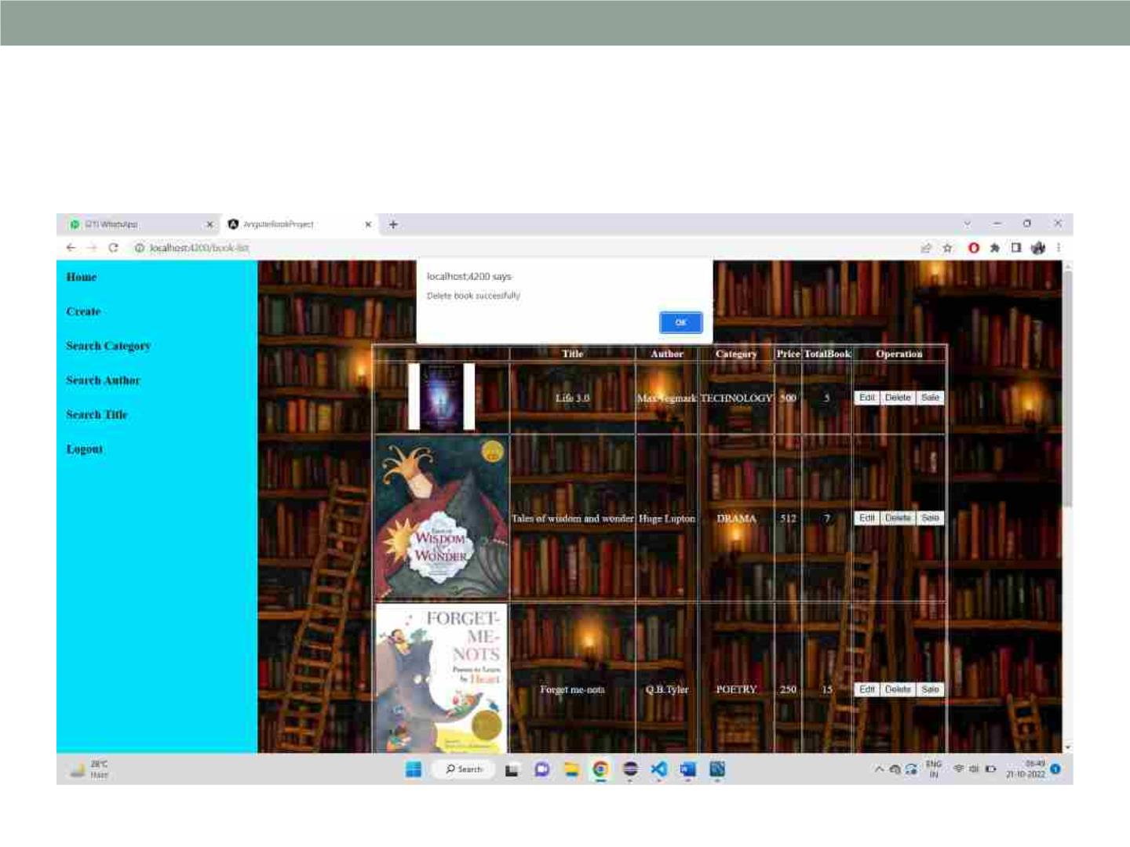
For deleting:

Slide 36
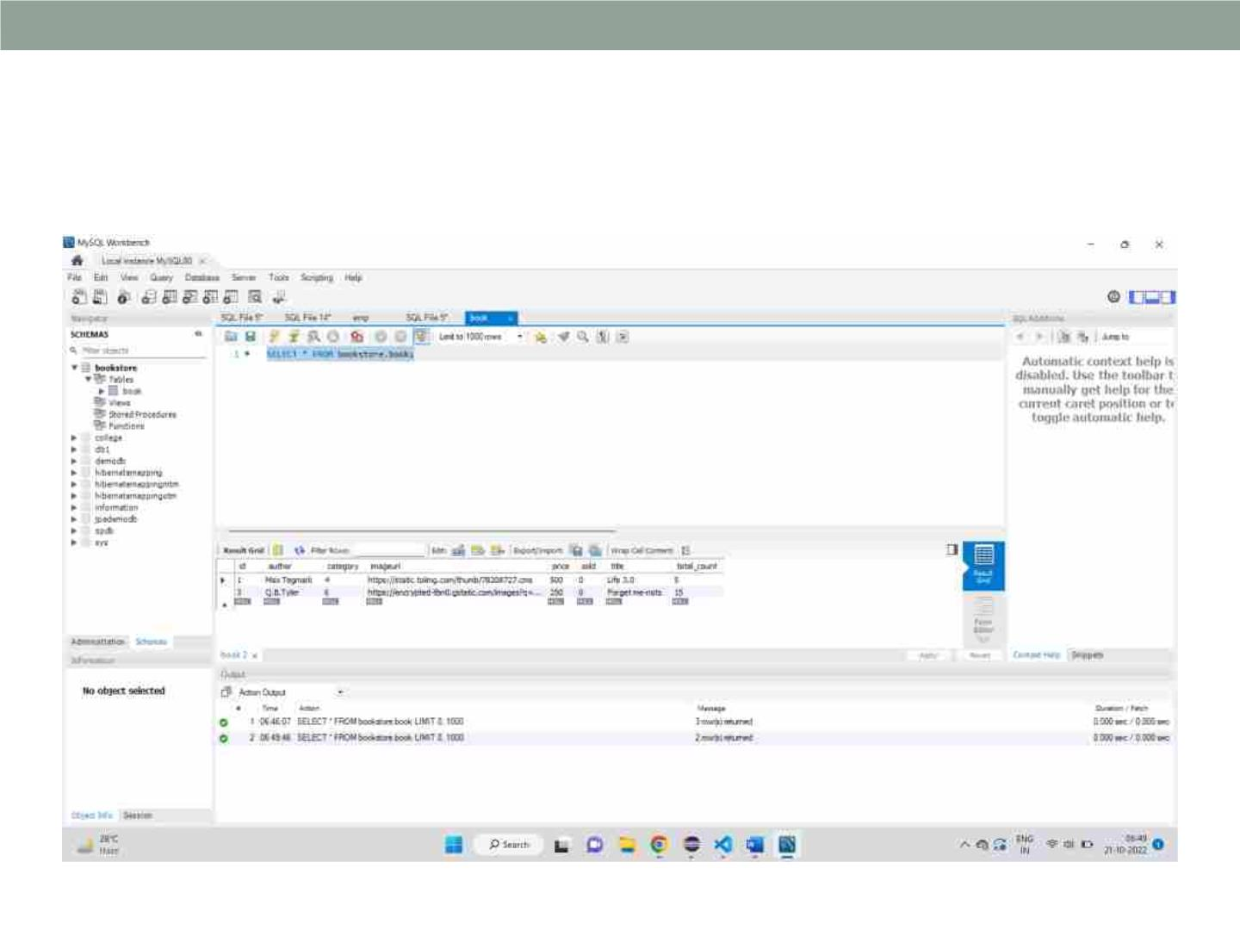
Data is deleted from database:

Slide 37
Conclusion
• Automatic Book Store has Many Advantages compare
to Manual. This Book Store is time consuming or easy
to use .This does not need to wait for shop keeper for
purchases book or sold.
• Admin can add, delete and update the author,
book categories.

Slide 38
Thank you

